Slide 1
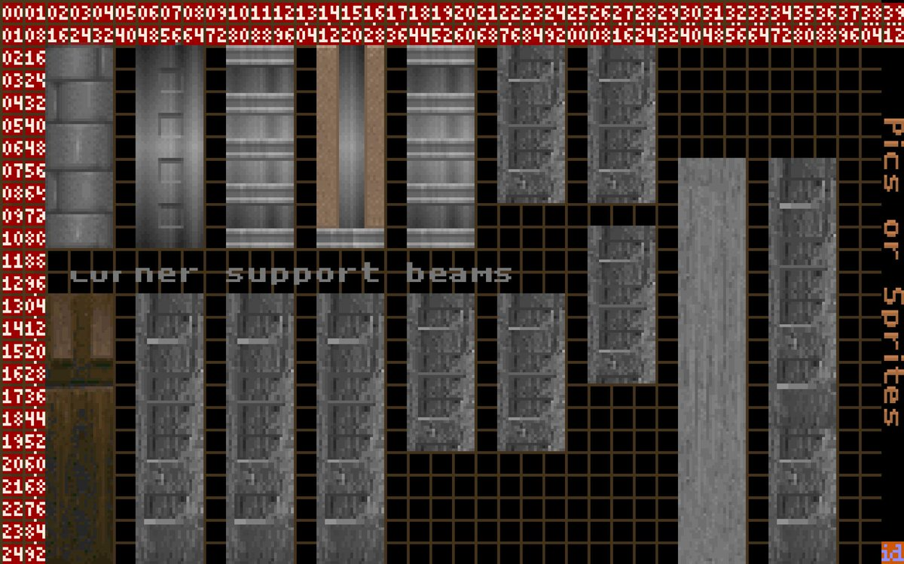












Slide 2
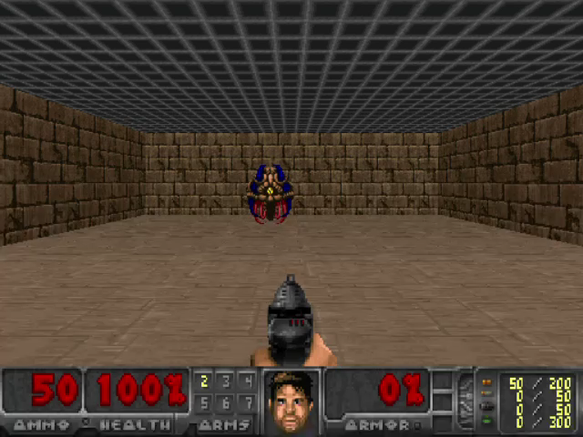




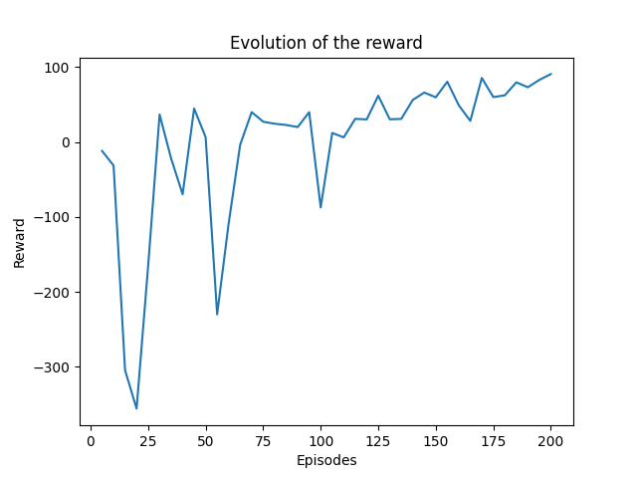








Slide 3






















$$Y_{t}=R_{t+1}+ γQ_{φ_{1}}(S_{T+1},\max_{a}{Q_{φ_{2}}(S_{T+1},a)})$$

Slide 4














Slide 5







